Slide 1
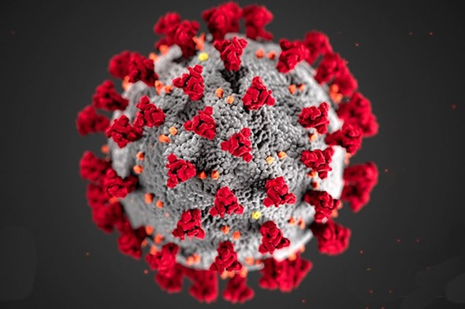
CORONAVIRUS
What you need to know
The COVID 19 pandemic is unfolding. Information presented is updated as of May 4, 2020 ITPC will refresh content to keep pace with new guidance.
For our latest tools and resources, please visit http://itpcglobal.org/covid-19

Slide 2
Overview
What is the coronavirus?
Who is at risk for COVID-19?
Transmission - how does COVID-19 spread?
Preventing COVID-19?
What happens if you get COVID-19?
People Living with HV & COVID-19
Tuberculosis (TB) and COVID-19
Testing
Treatment
Takeaways and resources

Slide 3
What is Coronavirus?

Slide 4
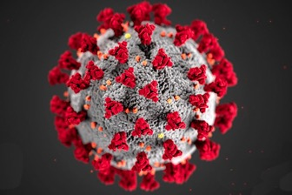
What is Coronavirus?
Coronaviruses are a large family of viruses in animals and people, including some that cause the common cold and other respiratory infections.
The name corona refers to a crown because these viruses have crown-like spikes on their surface.
The illness caused by coronavirus is called COVID-19.
On 7 January 2020, severe acute respiratory syndrome coronavirus 2 (SARS-CoV-2) was confirmed as the causative agent of coronavirus disease 2019 (COVID-19).
The term “COVID-19” is short way of saying “Coronavirus Disease 2019.”
COVID-19 is believed to have started in Wuhan, China, in December 2019.

Slide 5
What makes this a “novel” Coronavirus?
Sometimes coronaviruses that infect animals evolve and make people sick. These are known as a novel or new coronavirus.
The 2019 novel coronavirus came from animals into people (this is called zoonotic transmission). It is now spreading directly from person-to-person in most countries of the world.
Examples of previous coronaviruses include:
Middle East Respiratory Syndrome Coronavirus (MERS-CoV), first reported from Saudi Arabia in 2012
Severe Acute Respiratory Syndrome Coronavirus (SARS-CoV), first recognized in China in 2002.
The people who first became ill with COVID-19 were workers at a seafood, poultry and live wildlife market (called Huanan Seafood Wholesale Market) in the Jianghan District of Hubei Province of China.

Slide 6
Who is at Risk?

Slide 7
Who is at Risk for COVID-19?
Everyone! …which is why prevention is important!
Older adults (age >60 and people with pre-existing conditions are at high risk for serious illness/death from COVID-19)
People who have recently traveled to countries where COVID-19 is common (such as China, Iran, Italy, South Korea, Spain and the USA).
People who have been in close contact with a person who has COVID-19
Healthcare workers who do not have access to masks, gloves and gowns; they are heroically putting themselves at risk to care for others.

Slide 8
Transmission of COVID-19

Slide 9
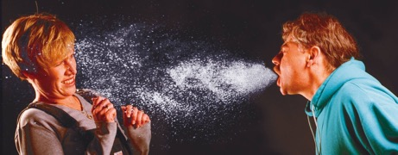
How Does Coronavirus Spread?
Coronavirus spreads through tiny droplets that go into the air when an infected person coughs or sneezes. These droplets also land on surfaces around the person with COVID-19.
Coronavirus can pass from person to person when people inhale these tiny droplets, or when people touch something that has coronavirus droplets on it and then touch their eyes, nose or mouth.

Slide 10
How Does Coronavirus Spread?
Although sick people are most likely to transmit COVID-19, people who do not have any symptoms can also spread it
People can transmit COVID-19 from 1 to 5 days before they have symptoms, and for up to 14 days after symptoms have ended
Some experts believe that the virus may also be airborne, spreading by aerosols - which are much smaller than droplets
Aerosols enter the air when people talk or exhale
They can travel further than droplets
Source: http://i-base.info/htb/37338

Slide 11
How Does Coronavirus Spread?
The coronavirus is also found in faeces (poop). Wash your hands thoroughly with soap and water, for at least 20 seconds, or use hand sanitizer after using the toilet.

Slide 12
Preventing COVID-19

Slide 13
How to Prevent COVID-19
Wash your hands often—and thoroughly—with soap and water for at least 20 seconds.
Do it when you enter your home, after using the toilet and after touching any object or surface used by many people. This is the most effective way to protect yourself.
You can also use hand sanitizer, if it contains at least 70% alcohol.
Do not touch your face unless you have just washed your hands thoroughly!
Wipe surfaces that are touched often (doorknobs, faucets, toilets, phones) with disinfectant at least once a day.
Notes:
Consider putting in a video with proper hand washing demo

Slide 14
How to Prevent COVID-19
Cover your mouth and nose when you are around sick people, or in public places with a mask or cloth.
This protects you —and other people. Even though people do not always feel sick from COVID-19, they can still spread it.
Masks may be difficult to find and are urgently needed for healthcare workers. If you do not have a mask, wear a scarf of cloth to cover your mouth and nose.

Slide 15
How to Prevent COVID-19
Stay away from hospitals and clinics unless you MUST be there.
If you need to pick up ARVs or other medicines, call first to find the least busy time – and stay at least 2 meters away from other people in the waiting room.
The better model is CAGS model (Community ARV Groups) where one person can SAFELY collect and distribute ARVs to members.
Try to get an extra supply of medicines for yourself and others in your community.

Slide 16
How to Prevent COVID-19
“Self-isolation is far more important than testing.” — Francois Venter, Deputy Executive Director, Wits Institute for Sexual & Reproductive Health, HIV and Related Diseases
It is very important for people who are sick to isolate themselves from others, to prevent COVID-19 from spreading.
It is also very important for people who are not sick to avoid going out whenever possible and stay more than 6 ft (2m) away from other people.
Do not hug, kiss or shake hands with other people.
This is called ‘social distancing.’
Source: World Health Organisation. Coronavirus disease (COVID-19) advice for the public. Taken from https://www.who.int/emergencies/diseases/novel-coronavirus-2019/advice-for-public. Accessed March 22, 2020.

Slide 17
Advice for Older Adults & People with Pre-existing Conditions
Plan and prepare for COVID-19 in your community.
Don’t go out unless it’s absolutely necessary (for medicines, food and emergencies).
It is best to avoid contact with other people as much as possible.
If you go outside, wear a mask or scarf over your mouth and nose and stay at least 2m away from other people
Do not hug, kiss, or shake hands with anyone else.
If someone in your home is sick, especially with symptoms of COVID-19, limit your contact with them as much as possible. Many people are becoming infected from their household members

Slide 18
Advice for Older Adults & People with Pre-existing Conditions
If you feel ill, call your healthcare provider/clinic before seeking care.
Clean and disinfect commonly touched surfaces in your home each day.
Avoid other people – but if you have visitors at home, cover your mouth and nose with a mask or cloth, and stay at least 2m (6 feet) apart.
Exchange waves, nods or bow to greet them.
Ask everyone who enters your home to wash their hands right away and to cover their mouth and nose.
Check reliable sources (such as World Health Organization) for updates.
See Resources at the end of this guide.

Slide 19
How can COVID-19 be Prevented?
If you are sick, isolate yourself from other people!
Cover your cough or sneeze with a flexed elbow or a tissue, then throw the tissue in the bin. Wash your hands more often!
Even if you are not sick, cover your mouth and nose with a mask, scarf or piece of cloth when you are around other people and in public.
Notes:
Consider putting in a video with proper hand washing demo
https://www.myotherapy.org.au/myotherapy-association-covid-19-updates/ photo from here

Slide 20
What happens if you get COVID-19?

Slide 21
What Happens to People who get COVID-19?
Experts are still learning about COVID-19.
Up to half of all people who have COVID-19 do not feel ill at all- but they can still spread it.
People are most likely to spread COVID-19 when they are feeling ill.
COVID-19 can become a serious, even deadly illness in some people
especially people > age 60 and people with underlying conditions (such as heart, lung or kidney disease, diabetes and hypertension).
Source: https://www.who.int/news-room/q-a-detail/q-a-coronaviruses;

Slide 22
What Happens to People who get COVID-19?
Most people with COVID-19 begin to feel ill 1 to 14 days after becoming infected.
Many people begin to feel sick 5-6 days after becoming infected.
Most people have mild symptoms (80%)
Some people never feel ill, or have very mild symptoms.
When you are sick, wear a mask to protect others. Change your mask regularly. Wash your hands after touching your mask.

Slide 23
What Happens to People who get COVID-19?
Symptoms include any or all of these:
cough (usually dry)
shortness of breath
sore throat
fever (≥ 38°C)
chills (and shaking)
muscle aches
skin rash
red and irritated eyes
diarrhea
headache
loss of sense of smell and taste
confusion, stroke, seizures (less common)
‘COVID toe’ – painful red rash on toes, heels and soles of the feet, usually in children, teens and young adults
Source: https://www.who.int/news-room/q-a-detail/q-a-coronaviruses; https://www.cdc.gov/coronavirus/2019-ncov/symptoms-testing/symptoms.html; https://www.nytimes.com/2020/05/01/health/coronavirus-covid-toe.htm; https://www.who.int/news-room/q-a-detail/q-a-coronavirusesl

Slide 24
People Living With HIV & COVID-19

Slide 25
People Living with HIV and COVID-19
Currently, there is no evidence that people living with HIV who are taking antiretroviral therapy (ART) are at higher risk for COVID-19.
There is no evidence that people living with HIV who are taking ART are at higher risk for severe illness from COVID-19
However, people with a high viral load and/or a CD4 cell count below 200 cells/mm³ – especially people with a CD4 cell count of <50 cells/mm - and/or a recent opportunistic infection are more vulnerable to COVID-19,
Source:
https://www.who.int/news-room/q-a-detail/q-a-on-covid-19-hiv-and-antiretrovirals. Accessed April 7 2020

Slide 26
People Living with HIV and COVID-19
People living with HIV who are not taking antiretroviral therapy (ART) are at higher risk for COVID-19 because their immune systems may be weaker.
It is important for people to be tested for HIV, and for people living with HIV to be taking antiretroviral therapy each day.
People who are taking ART should try to get at least 30 days worth of their medicines, and where possible get 3- to 6-month supply.
People living with HIV should be provided with vaccines to protect them against the flu and pneumonia.
Source: https://www.who.int/news-room/q-a-detail/q-a-on-covid-19-hiv-and-antiretrovirals. Accessed March 20, 2020.

Slide 27
Tuberculosis (TB) & COVID-19

Slide 28
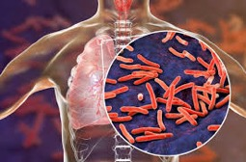
COVID-19 & Tuberculosis (TB)
HIV increases the risk of tuberculosis (TB), a bacterial infection which targets the lungs.
Antiretroviral therapy (ART) reduces this risk. It is important for people who have been at risk for HIV to get tested for TB, and for people living with HIV to have uninterrupted access to treatment, and to take it each day
Although it can be cured, TB is the leading killer of people living with HIV/AIDS. In 2018 it killed 251,000 people living with HIV.
Like TB, COVID-19 causes lung damage.
Scientists do not know how COVID-19 will affect people with TB, although they worry about people in these groups being at higher risk of illness and death.
Those most at risk of severe complications are older people, and adults and children with other underlying medical conditions such as lung disease.
Notes:
Photo from here
https://www.infectiousdiseaseadvisor.com/home/topics/respiratory/post-tuberculosis-lung-disease-in-hiv-associated-tuberculosis-common/

Slide 29
COVID-19 & Tuberculosis (TB)
COVID-19 is likely to have a bad impact on already inadequate TB services, making it harder for people to get tested and treated.
Those being tested for COVID-19 should be tested for TB—especially if they are living with HIV or are from areas where TB is common.
Governments should use the same urgency for TB and COVID-19 testing for people who have fever and a cough.

Slide 30
Testing

Slide 31
Should You Be Tested?
Access to viral load testing for COVID-19 is limited.
Ideally, everyone should be tested, but it is simply not feasible right now.
Globally, the healthcare system and people who work in it are overwhelmed with people who are seriously ill with COVID-19.
Generally, viral load testing is only recommended if you have symptoms (fever, coughing, difficulty breathing)
If you have symptoms, follow the policy in your country before going to seek medical treatment. Call your local health authority or go to a testing site.
If your viral load test result is negative, you can be still at risk for COVID-19. It is important to keep as safe as possible.
Source: Testing, testing, 123: Unpacking the confusion around SA’s Covid-19 testing. Taken from
https://www.dailymaverick.co.za/article/2020-03-19-testing-testing-123-unpacking-the-confusion-around-sas-covid-19-testing. Accessed on March 22, 2019.

Slide 32
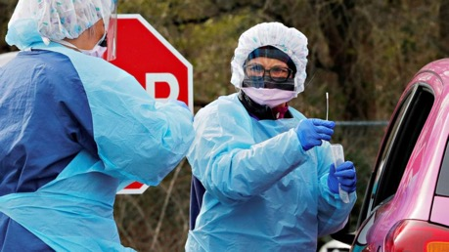
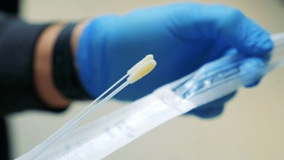
What Happens When You Get Tested
COVID-19 viral load testing should be done in an empty, well-ventilated room or outdoors to lower the risk to people getting tested and to healthcare workers.
A trained healthcare worker will use a swab to take a sample from the back of the nose and throat). The sample is then sent to a lab for testing. The test can be uncomfortable, but it is not painful.
The time it takes to get results varies depending on context (private/public, location, country, burden on health sector etc.)

Slide 33
Treatment

Slide 34
How is COVID-19 Treated?
There is no specific antiviral treatment available for COVID-19 yet, although many are being studied.
Current treatment is for symptoms, not the virus itself (e.g. pain medicines, oxygen for people with shortness of breath, treatment for fever, and plenty of fluids to avoid dehydration).
Antibiotics do not treat viral infections. However, antibiotics may be required if a bacterial secondary infection develops.
Goodman, J. (2020, March 21). Coronavirus and chloroquine: Has its use been approved in US? BBC. https://www.bbc.com/news/51980731
Fink, S. (2020, March 16). White House Takes New Line After Dire Report on Death Toll. New York Times. https://www.nytimes.com/2020/03/16/us/coronavirus-fatality-rate-white-house.html

Slide 35
How is COVID-19 Treated?
There are NO approved medicines to treat, cure or prevent COVID-19.
Should you take ibuprofen if you have COVID-19?
There's a lot of speculation and very little data on this.
For now, until we know more, if you have a headache or fever and think you are at risk for COVID-19, use paracetamol/acetaminophen, not anti-inflammatory drugs such as ibuprofen or cortisone.
The anti-malarial drug chloroquine is not an approved treatment for COVID-19. However, studies are being conducted now to see if it works.
Vaccine development can take years. This is why prevention is so important!

Slide 36
Takeaways and Resources

Slide 37
Key Takeaways
Cover your mouth and nose with a mask, scarf or cloth when you are in public places and/or around other people
If you are sick, stay away from other people; if you are healthy avoid sick people
Wash your hands with soap and clean water for at least 20 seconds regularly. If the absence of soap and water, 70% alcohol-based gel sanitizers should be used.
Places to think about sanitizing include your:
Car – steering wheel, keys, door handles, gear box, handbrakes etc.
Home – remotes, door handles, light switches, frequently used surfaces, cellphones, faucet handles, fridge doors etc.
Office – keyboard, phones, screen buttons, all phones, door handles, tea kettle nobs, light switches etc.

Slide 38
Key Takeaways
Establish a plan for clinical care if isolated/quarantined.
Plan WHERE in your house quarantine would happen and HOW it will work with your house-mates. Explain to children how it would work if needed. Do a dry run of what you can do and cannot do.
Tele-medicine options (Who can you call for clinical help? Hotlines, doctors, nurses etc.)
Top-up on data for calls and internet (as needed)
Find your local physician online portals and hotlines
Don’t wait to be sick to have a plan!
Maintain a social network, but remotely. Although you may be distanced physically, stay connected to your network.
Social contact helps us stay informed and updated and helps us stay mentally healthy.

Slide 39
Key Takeaways
Try to keep at least a one-month supply of chronic meds at your home. Where possible get the maximum your prescription/doctor will allow. We are advocating at a national level for multi-month scripting for HIV medicines up to 6 months.
Do not go the clinic if you do not have symptoms.
Smoking harms your lungs. Try to cut down or quit smoking.
It is essential to practice physical distancing ahead of the peak of the epidemic before – and after – the government mandates it.

Slide 40
Where possible, provide support to people in these situations:
People who may be in situations of domestic violence
Incarcerated people
People who live in shelters or other group settings
Persons who share homes with older people or those with pre-existing conditions making them at higher risk
Persons who do have no access to housing or water
People who live alone

Slide 41
Where possible, provide support to people in these situations:
Persons who may be unable to work remotely and lost their income due to the impact of government restrictions
Persons facing stigma related to coronavirus disease, including people of Asian descent or those who have traveled recently
Persons affected by drug shortages (chronic meds, ARVs etc.)
Persons reliant on harm reduction services such as drop-in centers which may be affected by government bans on gathering in public, curfews, etc.

Slide 42
Resources
World Health Organization (WHO) - main COVID-19 page https://www.who.int/emergencies/diseases/novel-coronavirus-2019
World Health Organization (WHO) - Q and A on COVID-19 page
https://www.who.int/news-room/q-a-detail/q-a-coronaviruses
WHO Q&A on COVID-19, HIV and Antiretrovirals
https://www.who.int/news-room/q-a-detail/q-a-on-covid-19-hiv-and-antiretrovirals
WHO COVID-19 advice for the public: Myth busters
https://www.who.int/emergencies/diseases/novel-coronavirus-2019/advice-for-public/myth-busters
ITPC Personal and Community Guidance on COVID-19 (April 8, 2020)
http://itpcglobal.org/resource/personal-and-community-guidance-on-covid-19-april-8-2020/
Frequently Asked Questions – Centers for Disease Control (CDC)
https://www.cdc.gov/coronavirus/2019-ncov/faq.html - anchor_1584386215012

Slide 43
Resources
The Corona Virus Explained and What you Should do
https://www.youtube.com/watch?v=BtN-goy9VOY
How and Why to Wash your Hands Properly
https://www.youtube.com/watch?v=-LKVUarhtvE
How to Make a Face Mask Without Sewing
https://www.theguardian.com/us-news/2020/apr/06/how-to-make-no-sew-face-mask-coronavirus
How Coronavirus Hijacks your Cells
https://www.nytimes.com/interactive/2020/03/11/science/how-coronavirus-hijacks-your-cells.html?action=click&module=RelatedLinks&pgtype=Article
How to Wear a Cloth Face Covering (CDC)
https://www.cdc.gov/coronavirus/2019-ncov/prevent-getting-sick/diy-cloth-face-coverings.html

Slide 44
The COVID 19 pandemic is unfolding. Information presented is updated as of May 4, 2020. ITPC will refresh content to keep pace with new guidance.
For our latest tools and resources, please visit http://itpcglobal.org/covid-19

